Slide 1
Quantum mixology
A study of particle physics
through cocktails

Slide 2
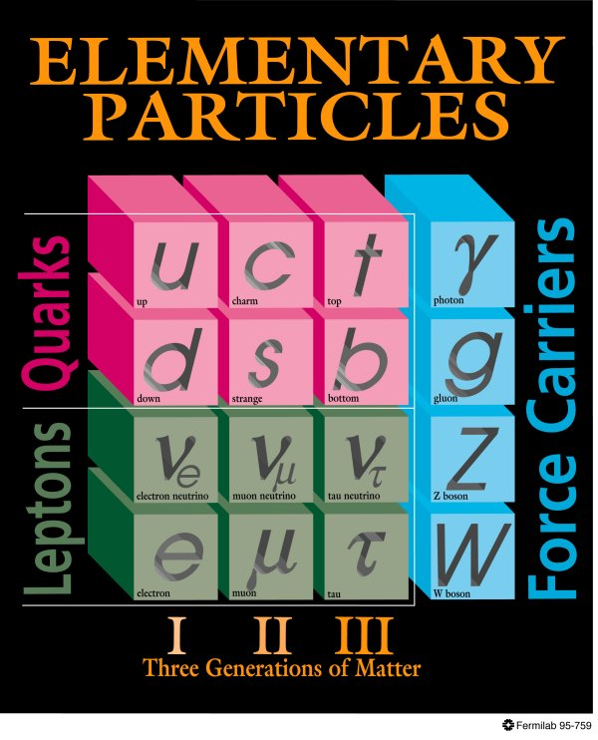
What particle physicists know

Slide 3
For new standard model in drinks

Slide 4
Some basic recipes
p = uud = ice + ice + vodka = vodka on the rocks
n = udd = ice + vodka + vodka = vodka on the rocks (stronger)
Λ = uds = ice + vodka + bitters = vodka bitters
π⁺ = u d-bar = ice + vodka/olives = extra dry vodka martini
K⁰ = d s-bar = vodka + bitters/cherry = vodka bitters with cherry
D⁺ = c d-bar = vermouth + vodka/olives = vodka martini
B⁺ = u b-bar = ice + red wine/orange rind = sangria
H atom = uud + e = ice + ice + vodka + gin = extra dry gin and vodka martini
Decayed π -> W -> μ + ν_{μ} = whiskey + soda + lemon
Decayed Z -> τ + ν_{τ} = rum + coke + lime
Decayed W -> e + ν_{e} = gin + tonic + lemon
Higgs -> ZZ -> μ⁺ + μ⁻ + e⁺ + e⁻ = whiskey + gin + lime

Slide 5
Manhattan project
+ c + anti-s
1 part Whiskey
1 part Vermouth
Dash of Bitters
Cherry

Slide 6
Old fissioned
μ + ν_{μ} + anti-s + g
1 part Whiskey
1 part soda water
Dash of bitters
Cherry
Sugar

Slide 7
Three Mile Long Island
d + e⁻ + τ + γ + ν_{τ}
1 part Vodka
1 part Gin
1 part Rum
1 part Orange Juice
Top with Coca-Cola

Slide 8
Cosmos
g + Z + d
1 part Vodka
1 part Lime Juice
Dash of simple syrup

Slide 9
μ-York Cocktail
μ + Z + g
1 part Whiskey
1 part Lime Juice
Dash of simple syrup

Slide 10
Mai τ∗
Z + τ + g
1 part Rum
1 part Lime Juice
Dash of simple syrup
* Beyond Standard Model recipe

Slide 11
(Surely You’re Joking)
Mr. Feynman
W + t-bar
1 part Tea
1 part Lemon Juice
Dash of cream

